Slide 1

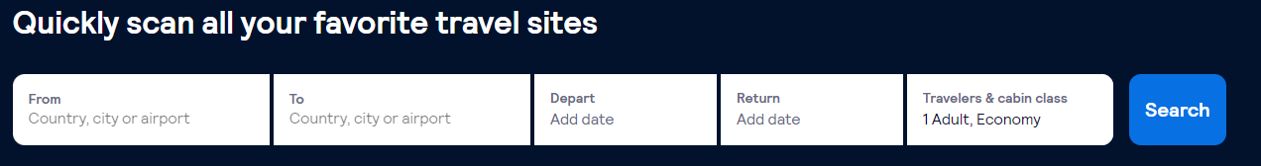

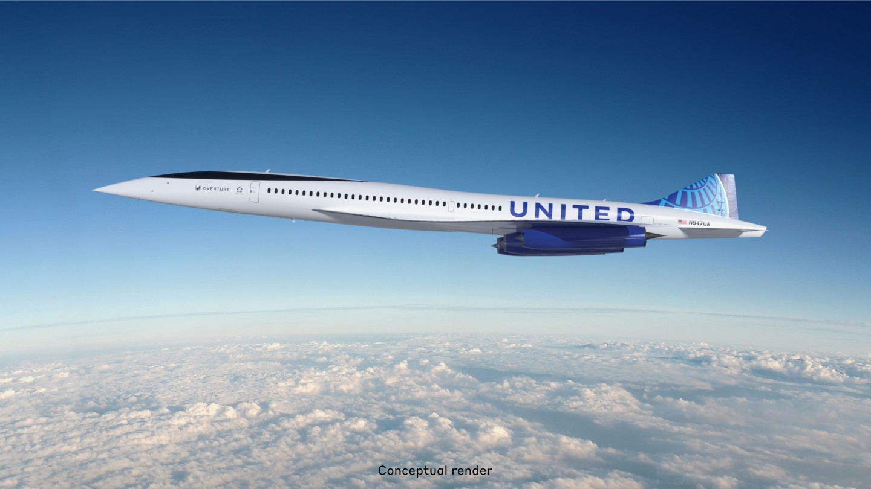

Main page
https://www.skyscanner.co.il/
Refer to slide 2
Sign up
Quickly scan and book today your next flight
The fastest scan engine
Refer to slide 3

Slide 2
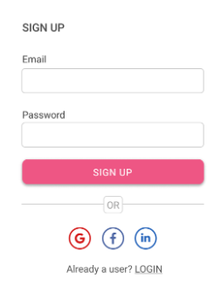
Log in page
Signup page
First Name
Last Name
Address
Phone no
email
Username
password
Credit card no
Submit

Slide 3

Flights page
My_flights page
Filter by company
Destination image
From:
To:
Departure date:
landing date:
Destination image
From:
To:
Departure date:
landing date:
Select
Destination image
From:
To:
Departure date:
landing date:
Select
Destination image
From:
To:
Departure date:
landing date:
Select

Slide 4
Admin page

Slide 5
My profile page

